Slide 1
Emotional Intelligence
Dr. Kajli Sharma

Slide 2
What Are Emotions?
Generally Speaking
Emotions are feelings that generally have both physiological and cognitive elements and that influence behaviour
By Dr. Kajli Sharma For T. E. – I.T.. Students

Slide 3
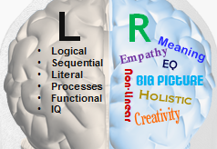
By Dr. Kajli Sharma For T. E. – I.T.. Students

Slide 4
Emotional Intelligence
Emotional Intelligence means using ‘thinking about feeling’ to guide our behaviour.
EI is the ability to identify, assess, and control the emotions of oneself and that of others.
According to Daniel Goleman, EI can be understood through personal competence and social competence.
By Dr. Kajli Sharma For T. E. – I.T.. Students

Slide 5

Also
Emotionally intelligent people have the ability to empathize, control impulses, communicate clearly, make thoughtful decisions, solve problems, and work with others.
They tend to have more satisfying relationships.
By Dr. Kajli Sharma For T. E. – I.T.. Students

Slide 6
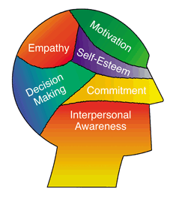
Areas Effected by EI
By Dr. Kajli Sharma For T. E. – I.T.. Students

Slide 7
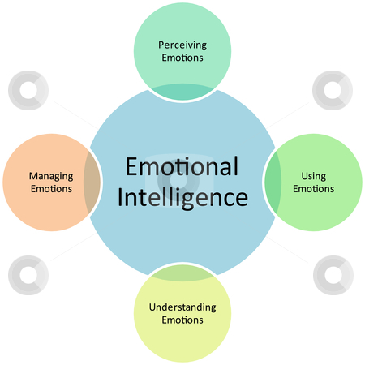
In Nut shell
By Dr. Kajli Sharma For T. E. – I.T.. Students

Slide 8
Emotional Skills
Personal Competencies and Social Competency
self-control, self management, empathy and social skills
Personal competencies
Emotional self-awareness – Recognizing our emotions and their effects.
Emotional self-control- Absence of distress and disruptive feelings
Self Motivation - The ability to use your emotions to cause yourself to take positive action to continue to persistently pursue goals even in the face of significant adversity or difficulty
By Dr. Kajli Sharma For T. E. – I.T.. Students

Slide 9
Social Competency
Social Awareness / Empathy - is the ability to read the inner minds of others and engage with them into an emotional dialogue
Social Skills / Relationship Management - is about inducing effective and desirable responses in others through various essential social skills
By Dr. Kajli Sharma For T. E. – I.T.. Students

Slide 10
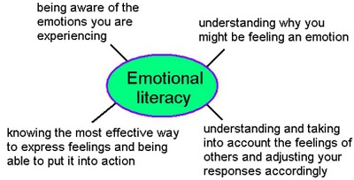
SUMMARY
EI Helps in
By Dr. Kajli Sharma For T. E. – I.T.. Students

Slide 11
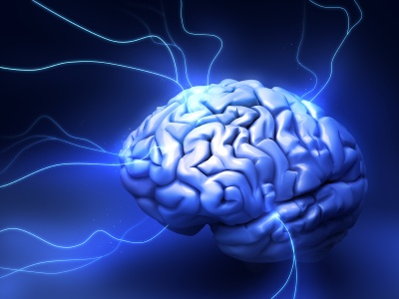
Also
The Reasons People Want To Change are
To Have Increased Effectiveness of Work or Potential to Work.
To Help Others to Develop Emotional Intelligence.
To Become Better Person.
By Dr. Kajli Sharma For T. E. – I.T.. Students

